Slide 1


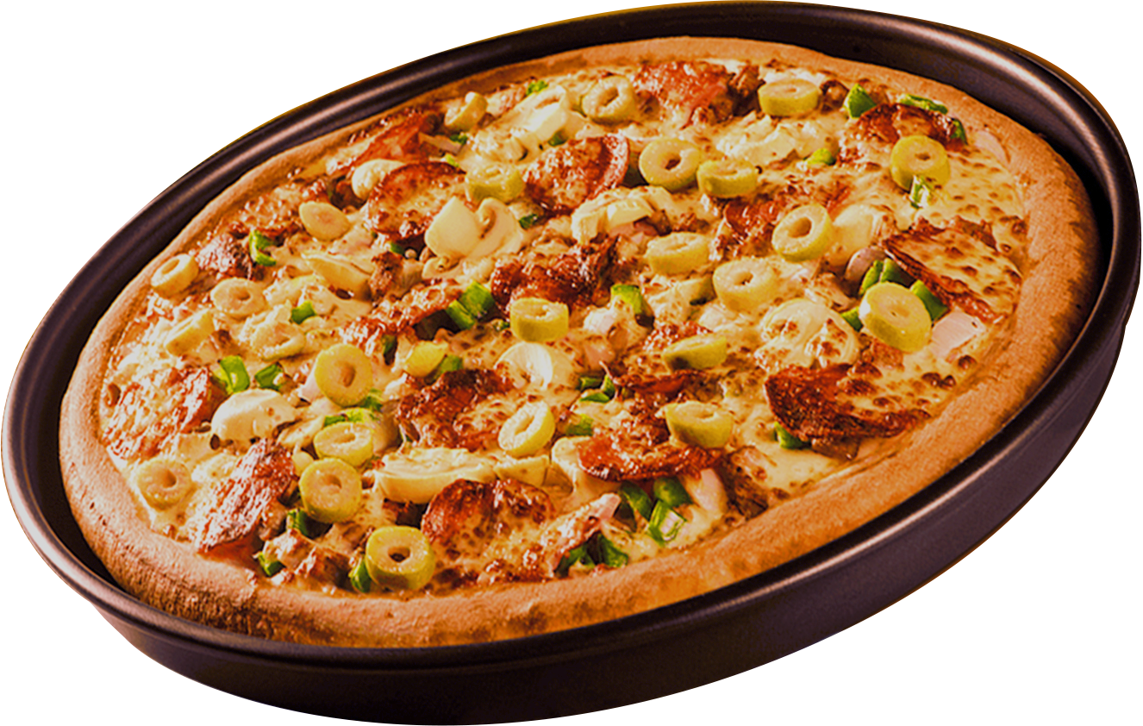

SLICE & DICE: A COMPREHENSIVE SQL CASE STUDY ON PIZZA SALES AND OPERATIONS

Slide 2
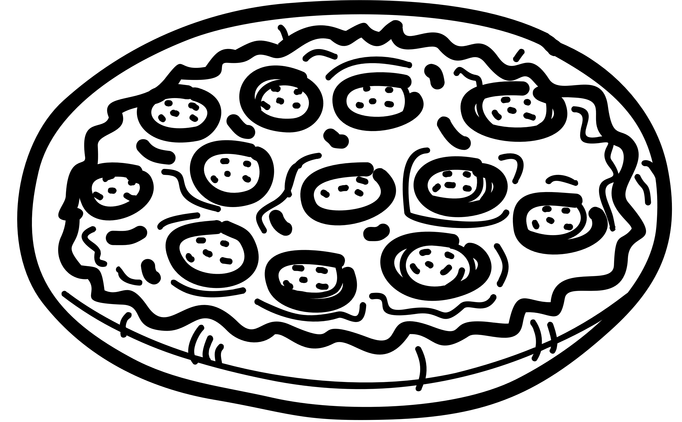
INTRODUCTION
THE MAIN GOAL OF THIS PROJECT IS TO USE SQL TO ANALYZE PIZZA SALES DATA. OUR GOAL IS TO PRODUCE ACTIONABLE INSIGHTS TO IMPROVE BUSINESS STRATEGY BY QUERYING MANY DATABASES PERTAINING TO ORDERS, PIZZA DETAILS, AND CONSUMER PREFERENCES. UNDERSTANDING CONSUMER BEHAVIOR, DEVELOPING ITEMS THAT GENERATE MONEY, AND STREAMLINING OPERATIONS FOR A FICTITIOUS PIZZA FIRM ARE THE MAIN GOALS OF THE CASE STUDY.

Slide 3
OBJECTIVE
ANALYZING OVERALL BUSINESS PERFORMANCE BY CALCULATING TOTAL ORDERS AND REVENUE.
IDENTIFYING POPULAR PIZZA TYPES, SIZES, AND CATEGORIES.
EXAMINING SALES TRENDS BY TIME AND DATE TO OPTIMIZE OPERATIONS.
GENERATING INSIGHTS ON HIGH-PERFORMING PRODUCTS BASED ON QUANTITY AND REVENUE.

Slide 4
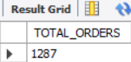
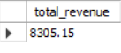
TOTAL NUMBER OF ORDERS
SELECT COUNT(ORDER_ID) AS TOTAL_ORDERS
FROM ORDERS;
TOTAL REVENUE FROM PIZZA SALES
SELECT ROUND(SUM(ORDER_DETAILS.QUANTITY * PIZZAS.PRICE), 2) AS TOTAL_REVENUE
FROM order_details
JOIN pizzas
ON order_details.pizza_id = pizzas.pizza_id;

Slide 5
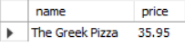
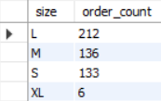
HIGHEST-PRICED PIZZA
SELECT PIZZA_TYPES.NAME, PIZZAS.PRICE
FROM pizza_types
JOIN pizzas
ON pizza_types.pizza_type_id = pizzas.pizza_type_id
ORDER BY pizzas.price DESC
LIMIT 1;
MOST COMMON PIZZA SIZE ORDERED
SELECT PIZZAS.SIZE, COUNT(ORDER_DETAILS.ORDER_DETAILS_ID) AS ORDER_COUNT FROM pizzas
JOIN order_details
ON pizzas.pizza_id = order_details.pizza_id
GROUP BY pizzas.size
ORDER BY order_count DESC;

Slide 6
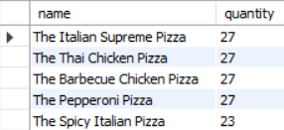
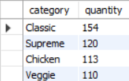
TOP 5 MOST ORDERED PIZZA TYPES
SELECT PIZZA_TYPES.NAME, SUM(ORDER_DETAILS.QUANTITY) AS QUANTITY
FROM pizza_types
JOIN pizzas
ON pizza_types.pizza_type_id = pizzas.pizza_type_id
JOIN order_details
ON order_details.pizza_id = pizzas.pizza_id
GROUP BY pizza_types.name
ORDER BY quantity DESC
LIMIT 5;
CATEGORY-WISE DISTRIBUTION OF PIZZAS
SELECT PIZZA_TYPES.CATEGORY, SUM(ORDER_DETAILS.QUANTITY) AS QUANTITY
FROM pizza_types
JOiN pizzas
ON pizza_types.pizza_type_id = pizzas.pizza_type_id
JOIN order_details
ON order_details.pizza_id = pizzas.pizza_id
GROUP BY pizza_types.category
ORDER BY quantity DESC;

Slide 7
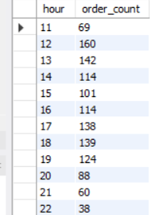
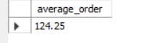
DISTRIBUTION OF ORDERS BY HOUR
SELECT HOUR(ORDER_TIME) AS HOUR, COUNT(ORDER_ID) AS ORDER_COUNT
FROM orders
GROUP BY HOUR(order_time);
AVERAGE PIZZAS ORDERED PER DAY
SELECT ROUND(AVG(QUANTITY), 2) AS AVERAGE_ORDER
FROM (
SELECT orders.order_date, SUM(order_details.quantity) AS quantity
FROM orders
JOIN order_details
ON orders.order_id = order_details.order_id
GROUP BY orders.order_date) AS order_quantity;

Slide 8
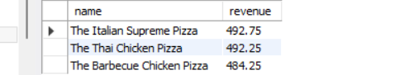
TOP 3 PIZZA TYPES BY REVENUE
SELECT PIZZA_TYPES.NAME, SUM(ORDER_DETAILS.QUANTITY * PIZZAS.PRICE) AS REVENUE
FROM pizza_types
JOIN pizzas
ON pizzas.pizza_type_id = pizza_types.pizza_type_id
JOIN order_details
ON order_details.pizza_id = pizzas.pizza_id
GROUP BY pizza_types.name
ORDER BY revenue DESC
LIMIT 3;

Slide 9
CONCLUSION
THE TOTAL NUMBER OF ORDERS AND REVENUE SHOWCASE THE BUSINESS'S SCALE AND PROFITABILITY.
POPULAR PIZZA SIZES AND TYPES INDICATE CUSTOMER PREFERENCES AND INFLUENCE INVENTORY MANAGEMENT.
UNDERSTANDING ORDER PATTERNS BY TIME AND DAY CAN OPTIMIZE OPERATIONS AND WORKFORCE ALLOCATION.
INSIGHTS INTO TOP REVENUE-GENERATING PIZZAS AND CATEGORIES SUPPORT TARGETED PROMOTIONS AND MENU ENHANCEMENTS.

Slide 10


THANK YOU!

